Slide 1

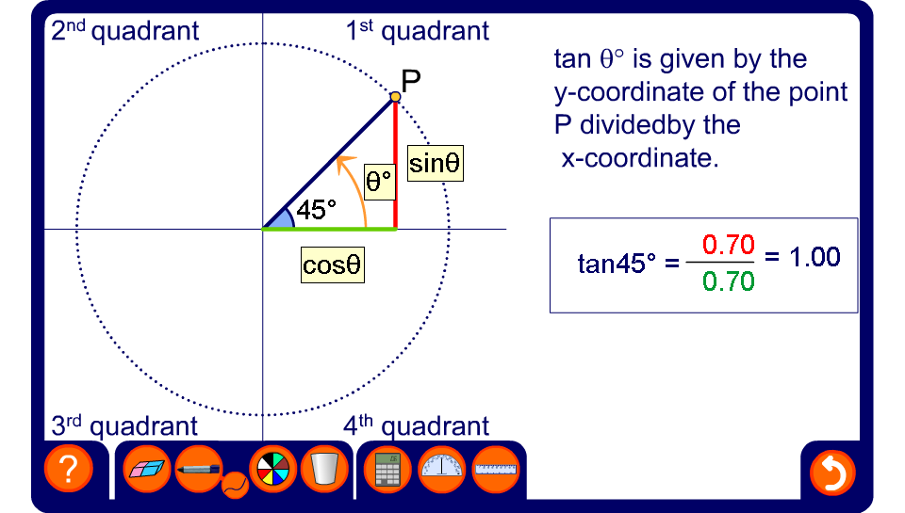


The tangent of any angle
Notes:
Remind pupils that tan θ is given by sin θ/ cos θ. Tan θ is therefore given by the y-coordinate of the point P divided by the x-coordinate of the point P.
Slowly, drag the point P through 360°, starting at 0° and ending at 360°. Observe the change in the value of tan θ as the point P is rotated. Point out that when P is in the first and the third quadrants, that is, when θ is between 0° and 90° or between 180° and 270°, the sin and cosine of the required angle is of the same sign. The tangent is therefore positive in these quadrants. The tangent of 90° and 270° is undefined when cos θ = 0 (because we cannot divide by 0).
When the point P is in the second and fourth quadrants, that is, when θ is between 90° and 180° and between 270° and 360° , the sin and cosine of the required angle is of different sign. The tangent is therefore negative in these quadrants.
Focusing on angles between 0° and 180° (that is, angles in the first and second quadrants) demonstrate the relationships between pairs of angles that have the same tangent, but are of opposite sign. For example, show that tan 127° = –tan 53°. Conclude that tan θ = –tan (180° – θ).
Focus next on angles between 180° and 270° (that is, angles in the third quadrant) . Show that tan θ = tan (θ – 180°).
In the fourth quadrant, examine angles between 270° and 360° and between 0° and –90°. Conclude that tan θ = –tan (360° – θ) for angles between 270° and 360° and tan –θ = –tan θ for angles between 0° and –90°.

